Slide 1
Housing Market Update Red Deer

Slide 2
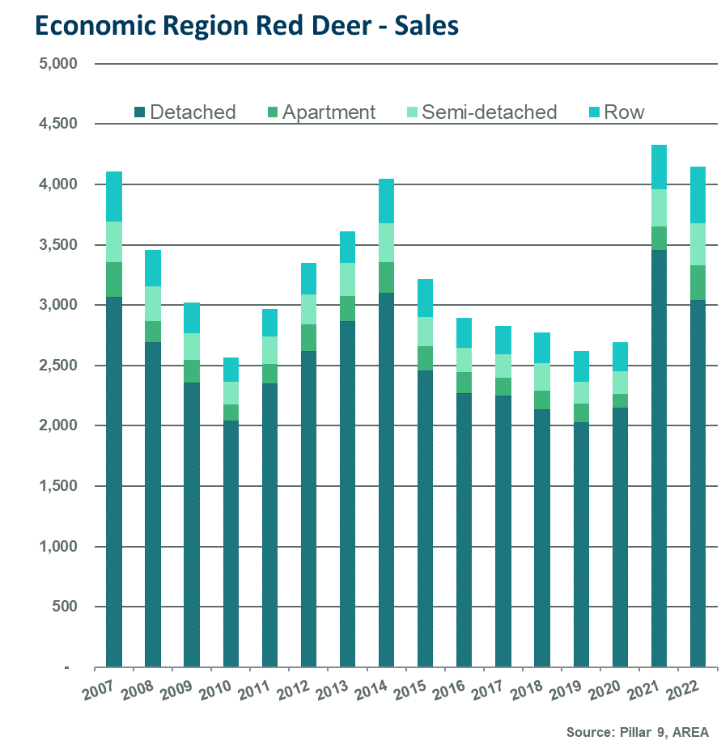
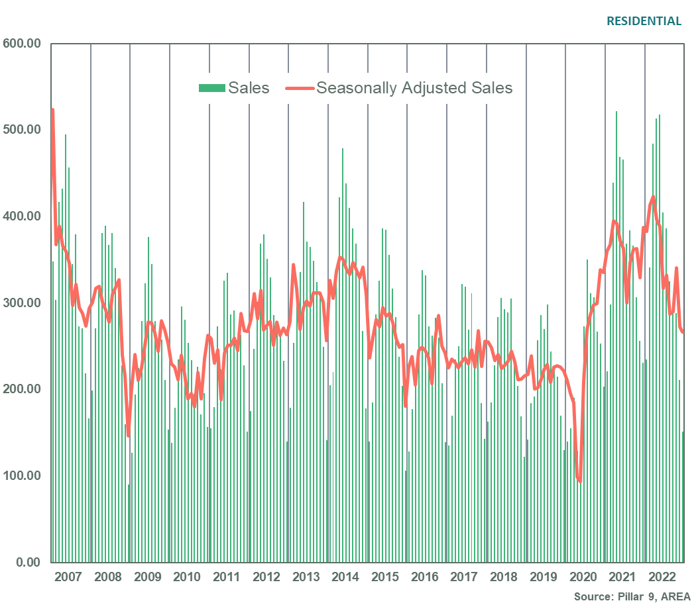
Sales slow from record highs

Slide 3
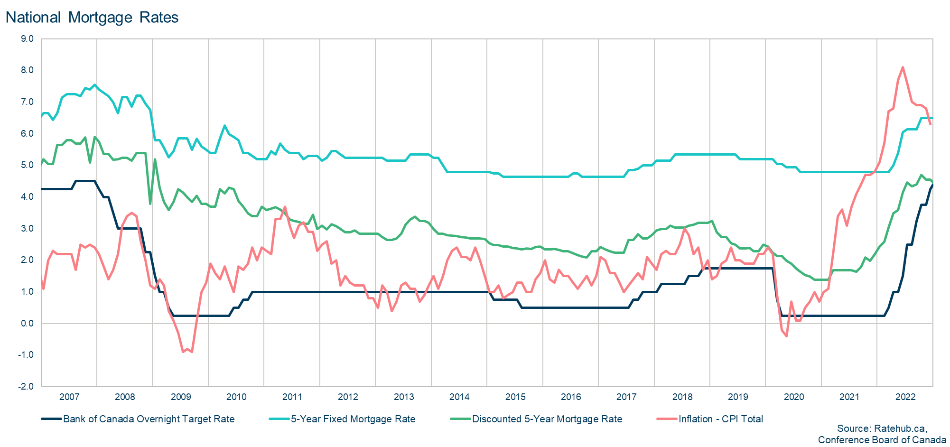
Higher lending rates weighing on housing
Notes:
-

Slide 4
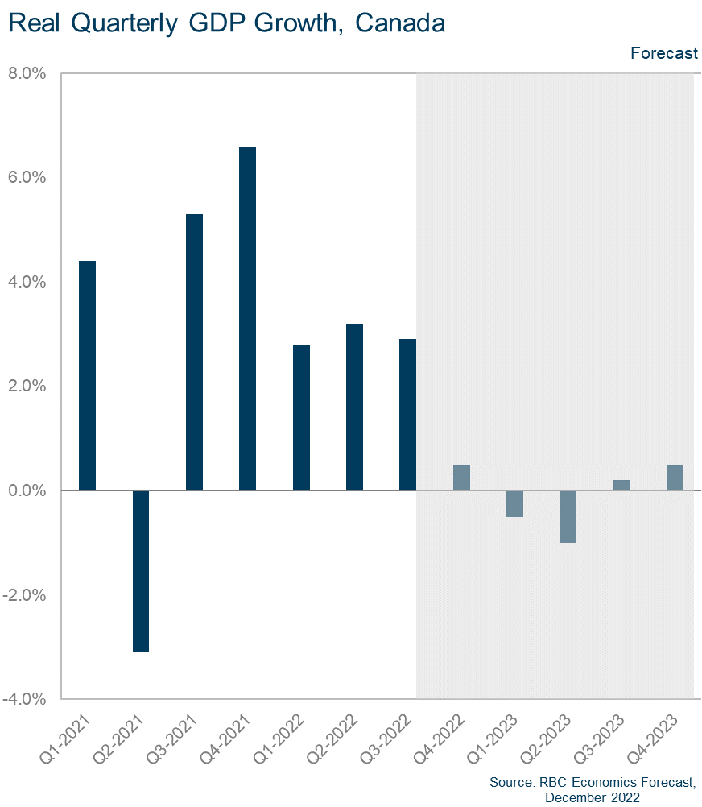
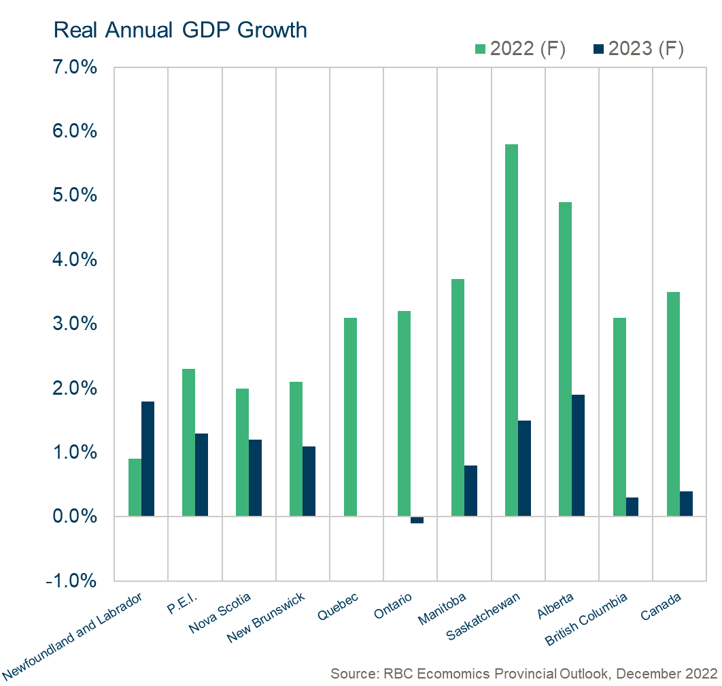
Alberta to lead the country in growth

Slide 5
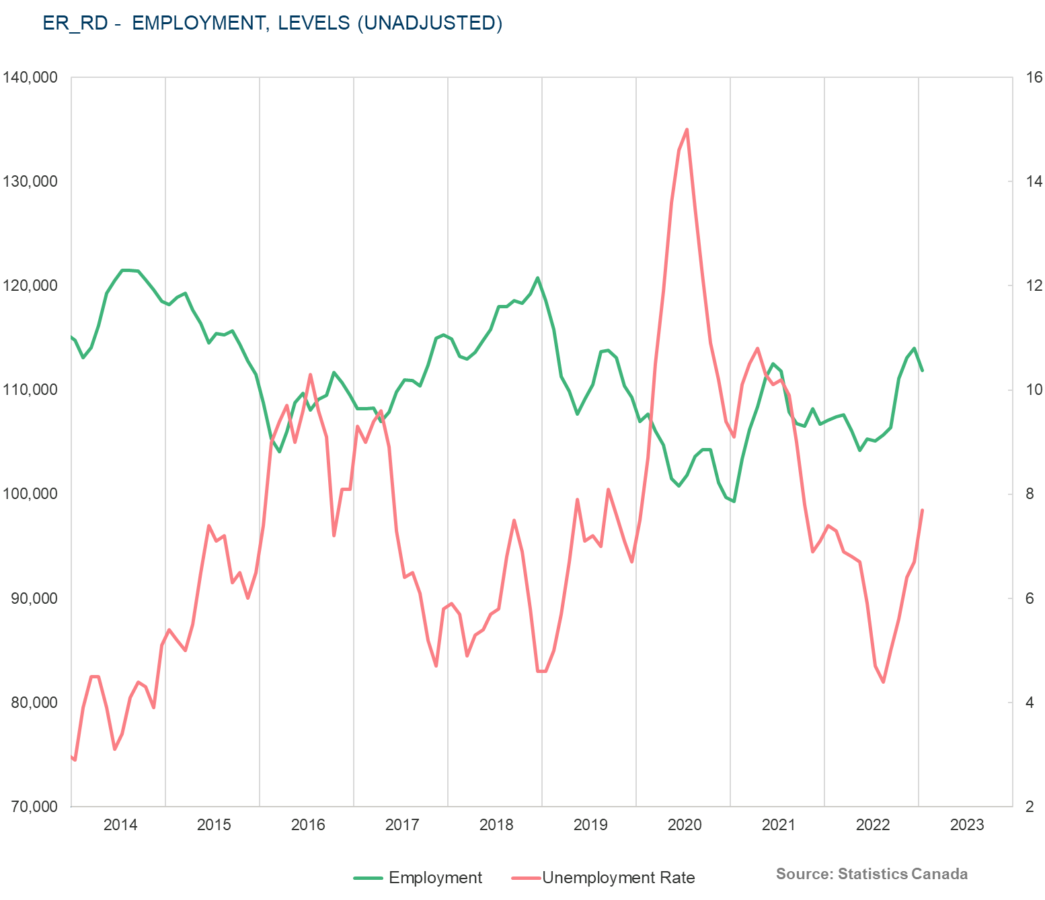
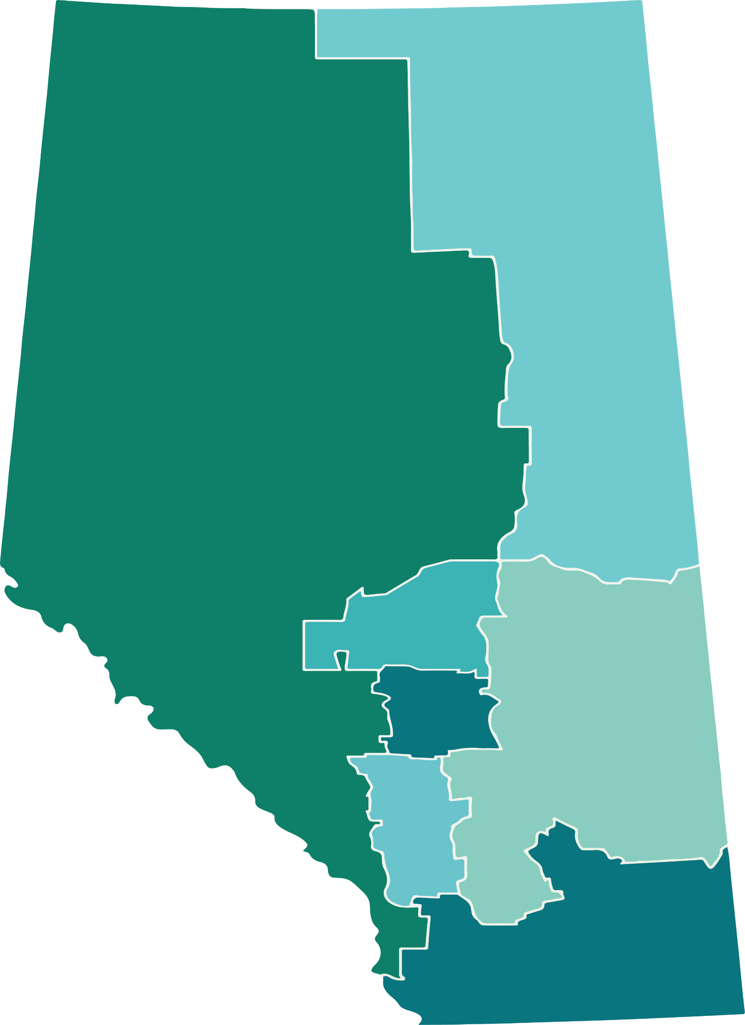
Rise in unemployment rate?
2022 – Employment Growth
Red Deer Economic Region
Wood Buffalo-Cold Lake
2.91%
Banff-Jasper-Rocky Mountain House-Athabasca-Grande Prairie-Peace River
2.95%
Edmonton
3.92%
Red Deer
Camrose-Drumheller
0.28%
7.01%
Calgary
6.85%
Alberta – 5.16%
Lethbridge-Medicine Hat
Canada – 3.96%
6.32%

Slide 6
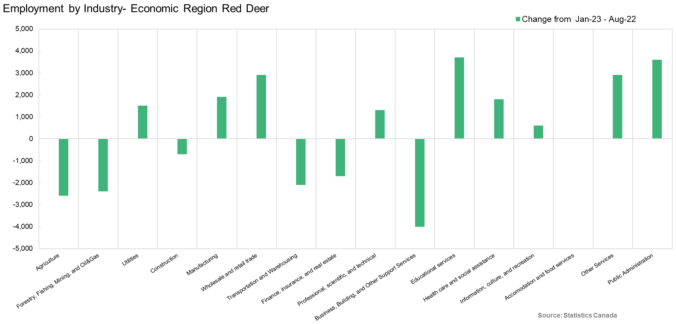
Activity varies by industry

Slide 7
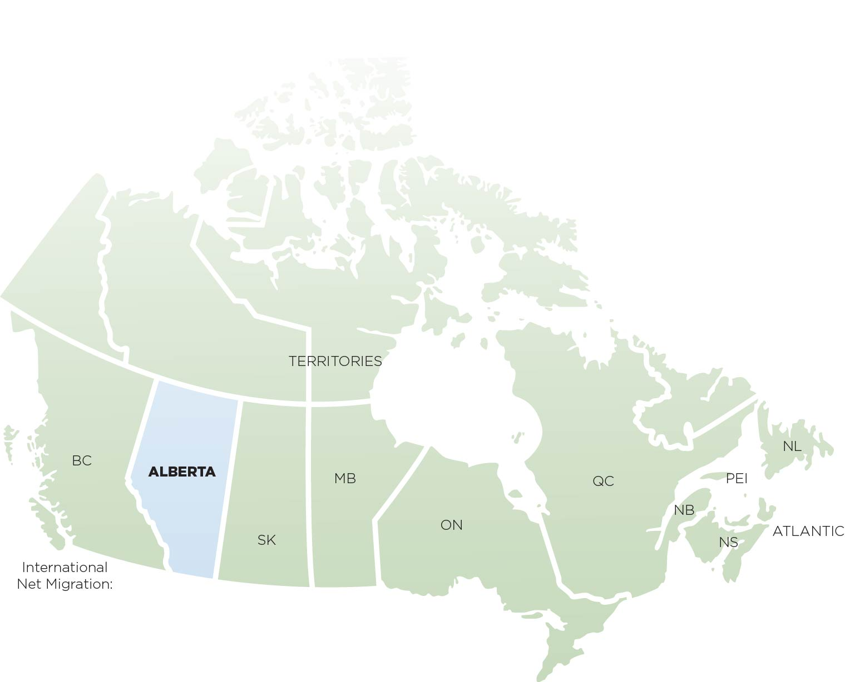
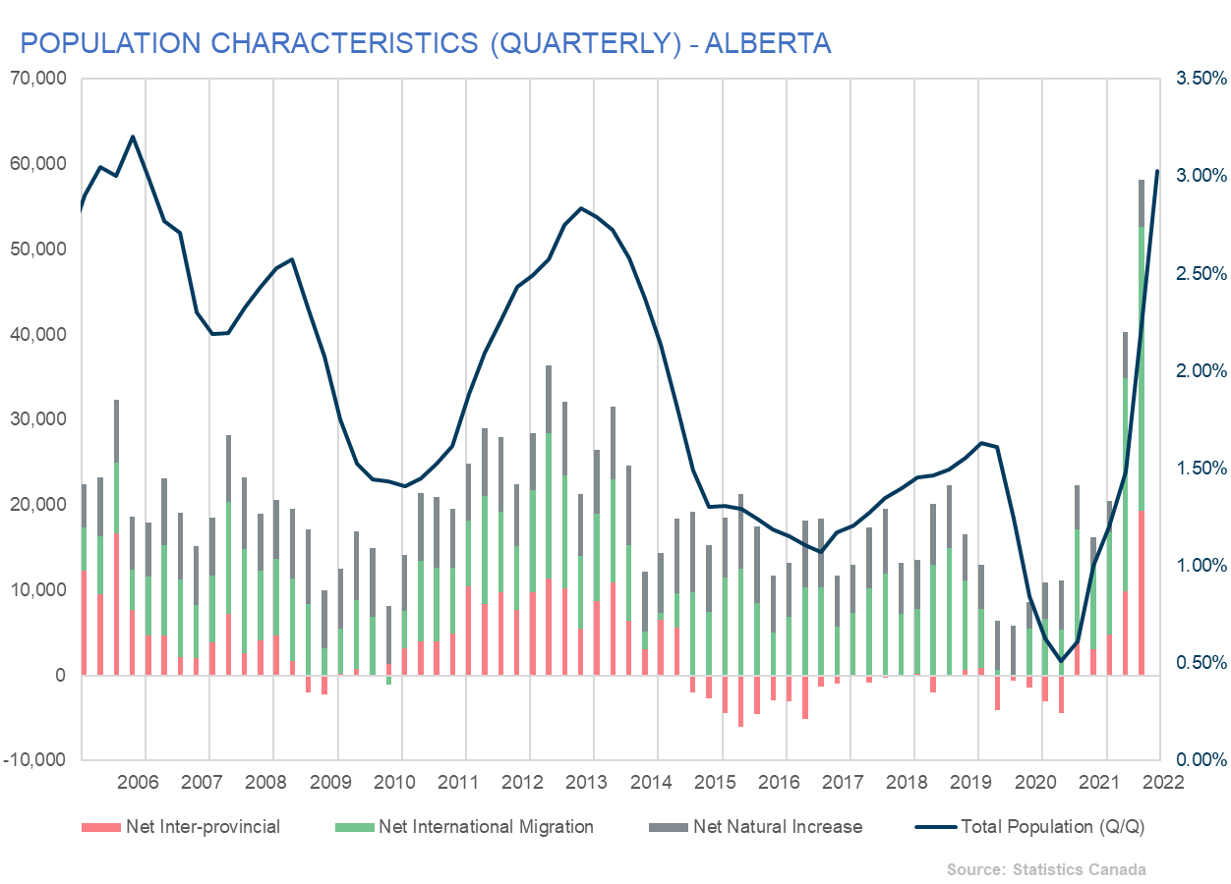
Q3 Record High Migration
Q3 Record High Migration
587
6,827
4,028
1,246
3,054
18,090
160
70,294
Source: Statistics Canada Q1-Q3 total

Slide 8
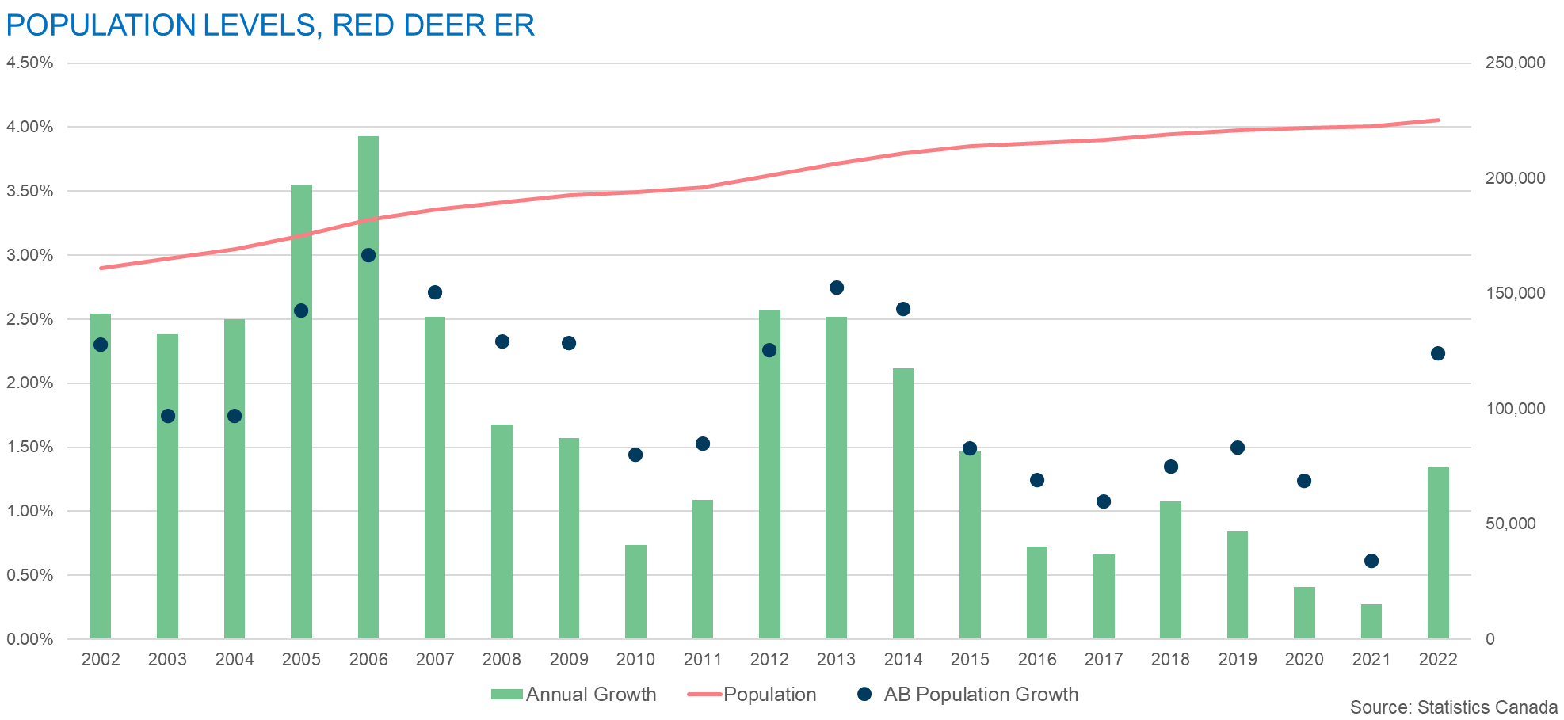
Population growth improves but…

Slide 9
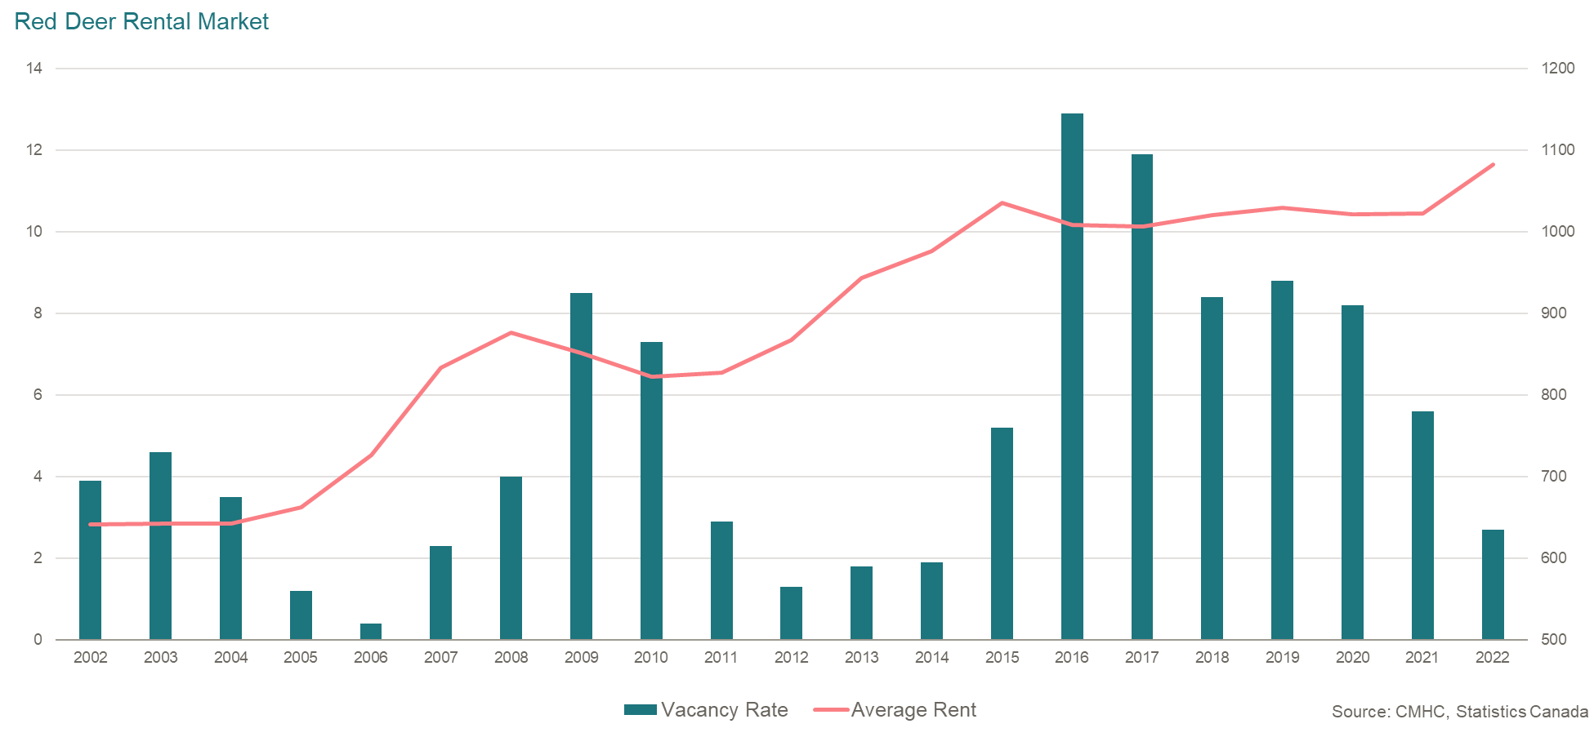
Rental Vacancies ease

Slide 10
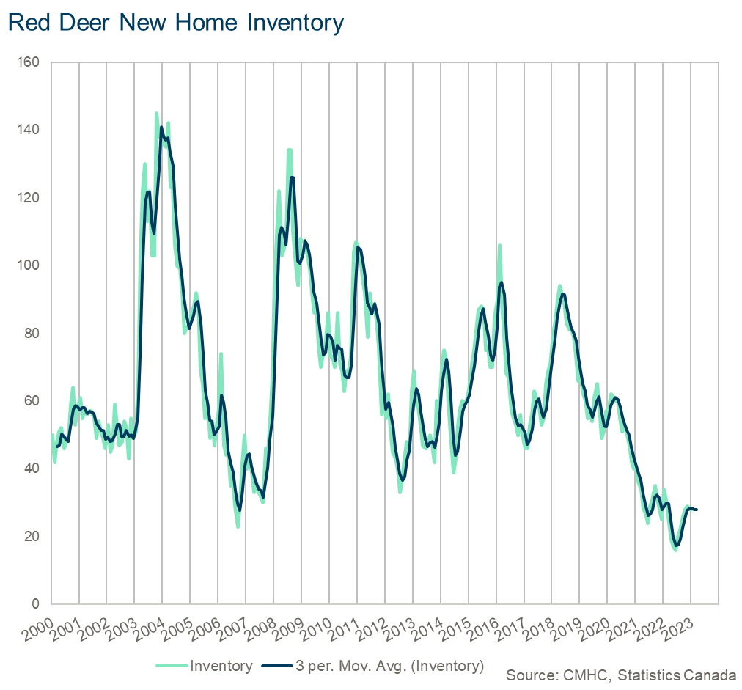
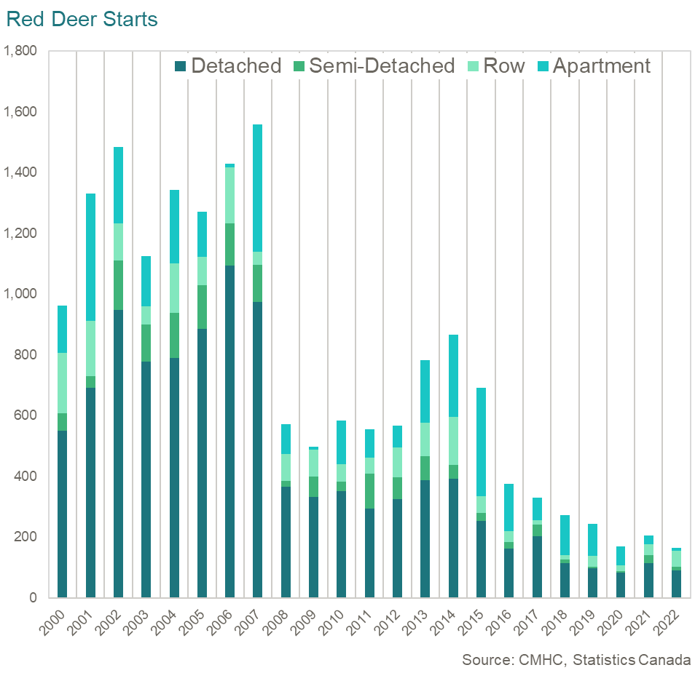
New Home starts and inventory low

Slide 11
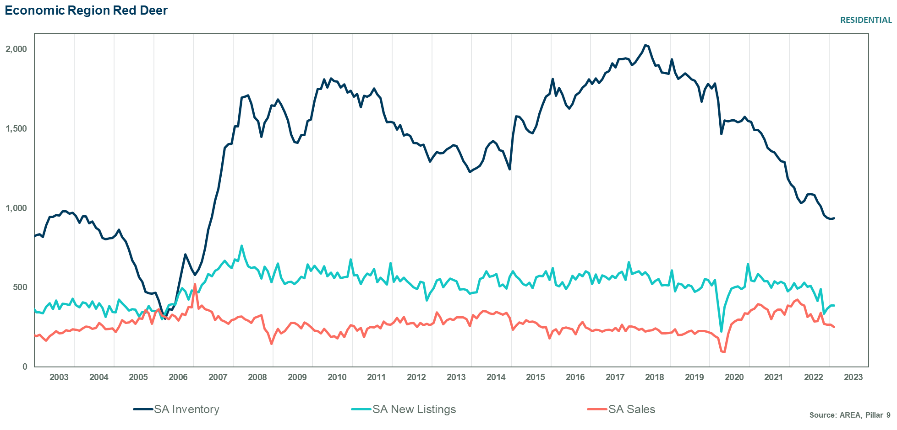
Inventory levels remain low

Slide 12
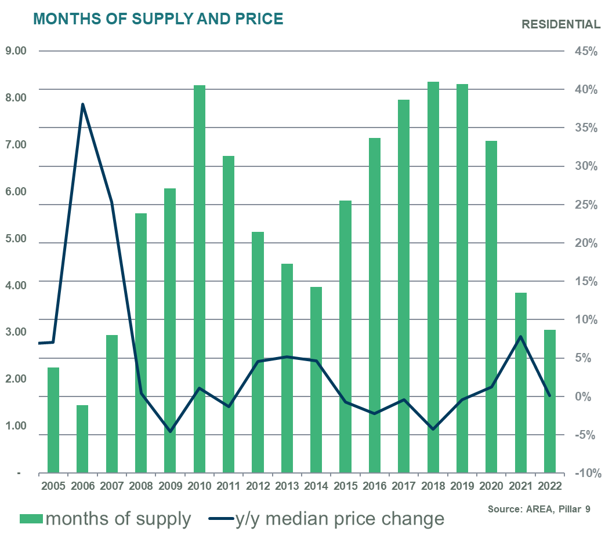
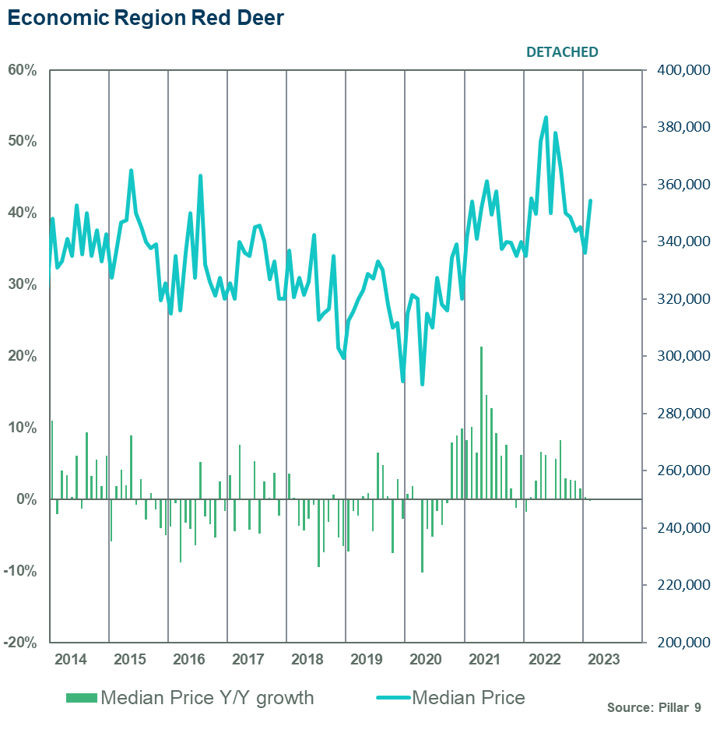
Tight market conditions yet prices flat?

Slide 13
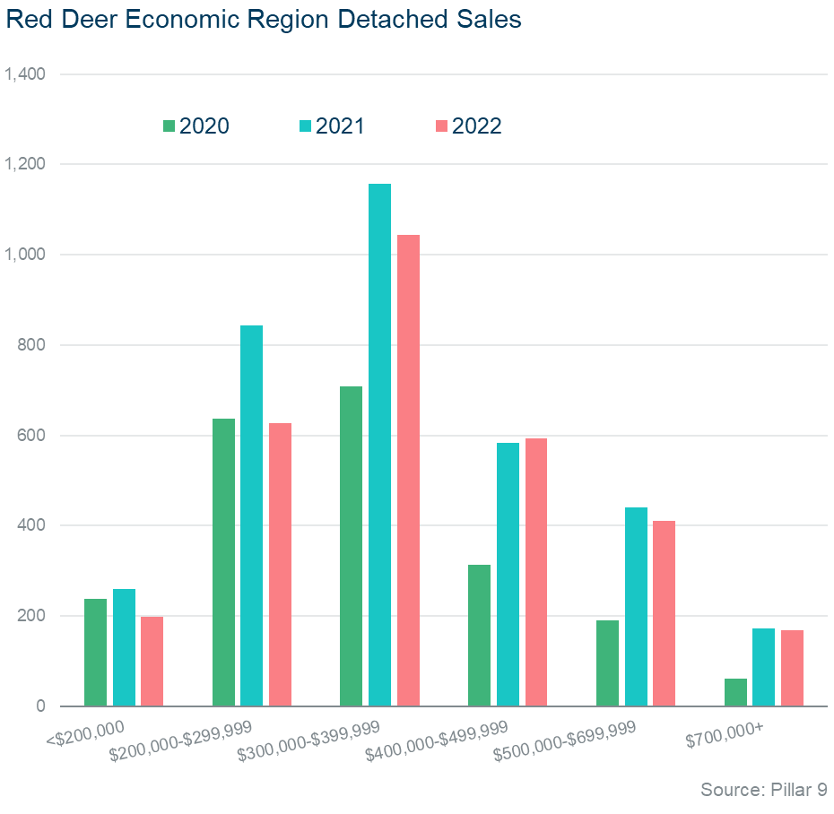
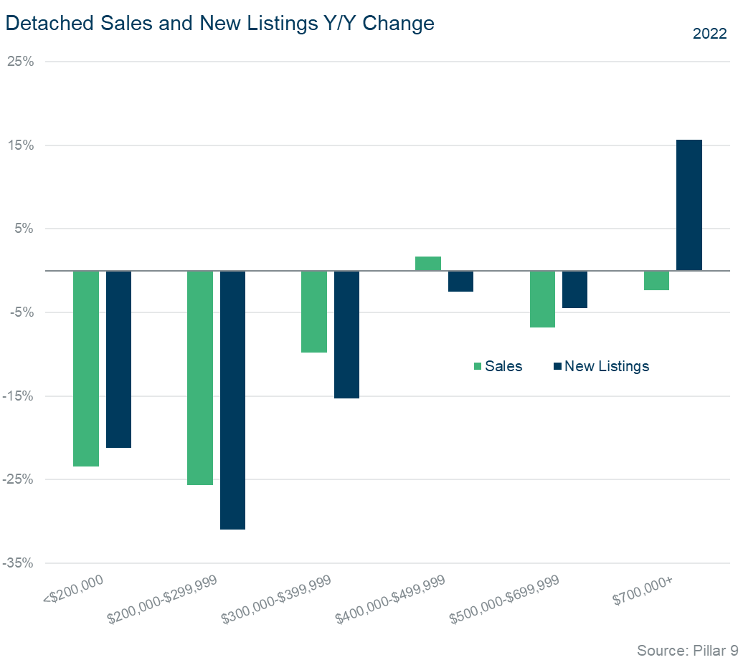
Listing reductions for low priced product impacting sales
Sales to new listings Ratio
81% 81% 78% 74% 66% 38%

Slide 14
Trends varied across the region
Economic Region – Red Deer | 2022 Sales | % Change | Average annual Inventory | 2022 Average Months of Supply | Median Price | Y/Y Change | Annual Peak
Lacombe County | 491 | - 11% Y/Y + 30% 10yr | 134 -22% | 3.3 ↓ 13% | $322,500 | + 0.8% | $328,000 2015
Ponoka County | 312 | - 20% Y/Y + 32% 10yr | 108 -29% | 4.2 ↓ 11% | $309,500 | - 0.1% | $309,900 2021
Red Deer County | 1,083 | - 9% Y/Y + 34% 10yr | 294 -24% | 3.3 ↓ 16% | $322,000 | - 0.2% | $322,500 2021
City of Lacombe | 289 | - 5% Y/Y + 31% 10yr | 70 -26% | 2.9 ↓ 23% | $340,000 | + 4.1% | New Peak
City of Red Deer | 1,972 | + 4% Y/Y + 24% 10yr | 447 -22% | 2.7 ↓ 26% | $320,000 | +0.3% | $325,000 2015
Total Economic region | 4,146 | - 4% Y/Y + 28% 10yr | 1,055 -24% | 3.1 ↓ 21% | $321,000 | + 0.3% | New Peak

Slide 15
Questions
Ann-Marie Lurie
Chief Economist
403-605-8704
Ann-marie.lurie@albertarealtor.ca

